Slide 1

All In One Place - Insiders Henrique Issamu Umeda - 2021

Slide 2

The Company

Slide 3
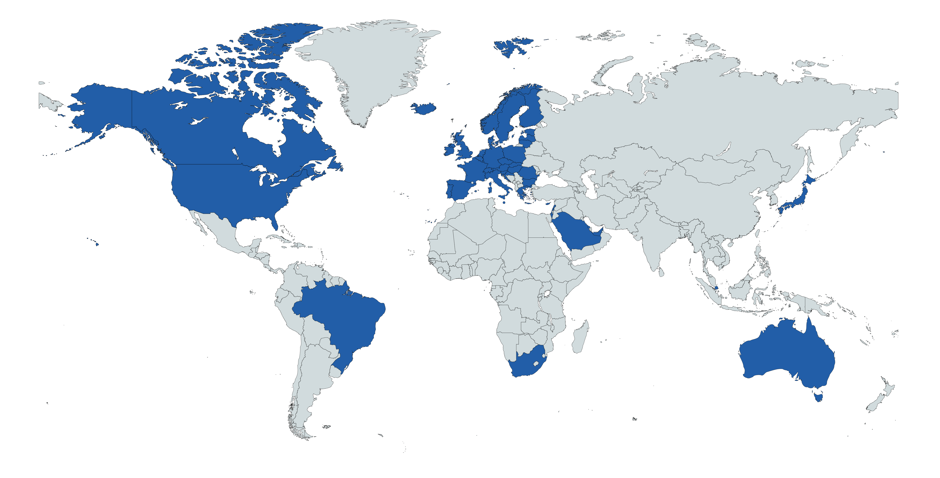





The Company
Who we are?
All In One Place Company | Multibrand Outlet | Well-established in E-commerce
We are in more than 40 countries
Main Countries
United Kingdom
Netherlands
Ireland
Germany
France

Slide 4
CUSTOMERS
PRODUCTS
REVENUE
Around 4,300 registered customers in 1 year of operation
Around 3,900 unique products, with more than 4.9 million products sold
Approximately US$ 8.3 million a year
The Company
Who we are?

Slide 5

Revenue

Slide 6
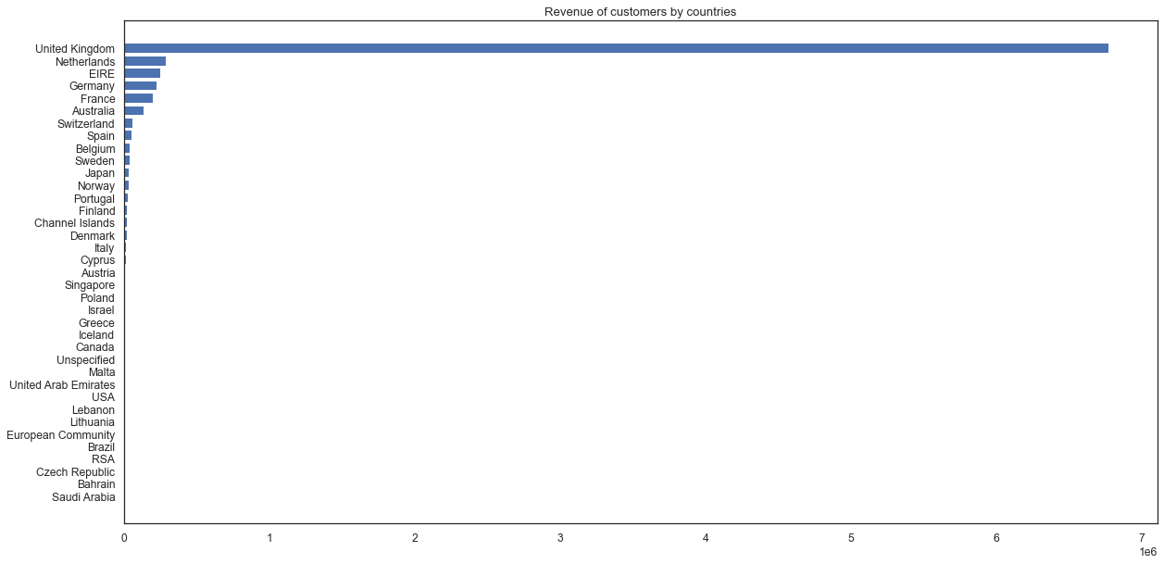
The Company
Revenue - Country

Slide 7
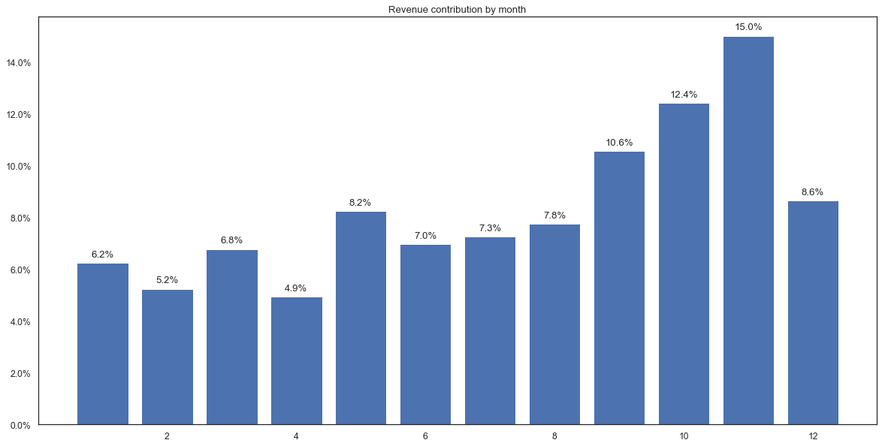
The Company
Revenue - Month

Slide 8
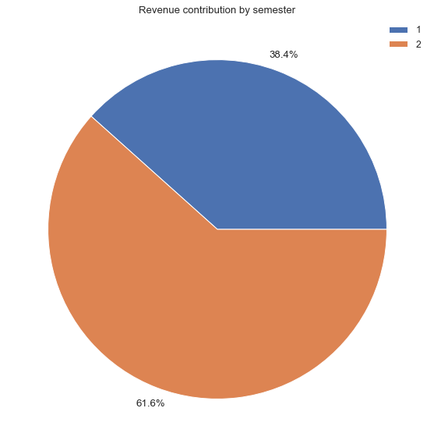
The Company
Revenue - Semester

Slide 9
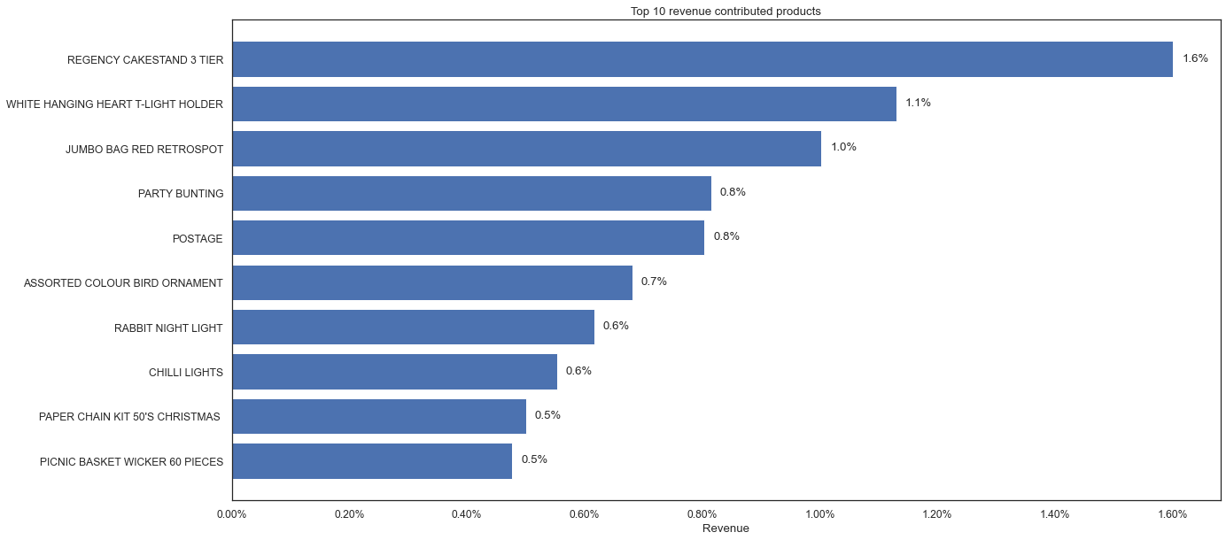
The Company
Revenue - Products

Slide 10
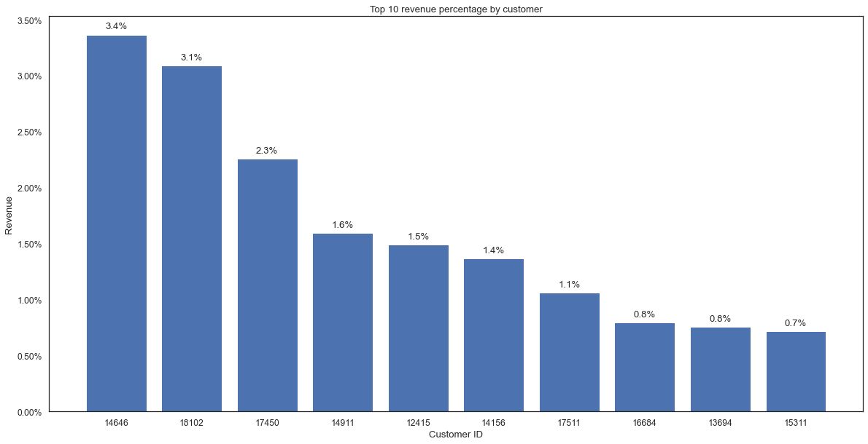
The Company
Revenue - Customers

Slide 11


Slide 12
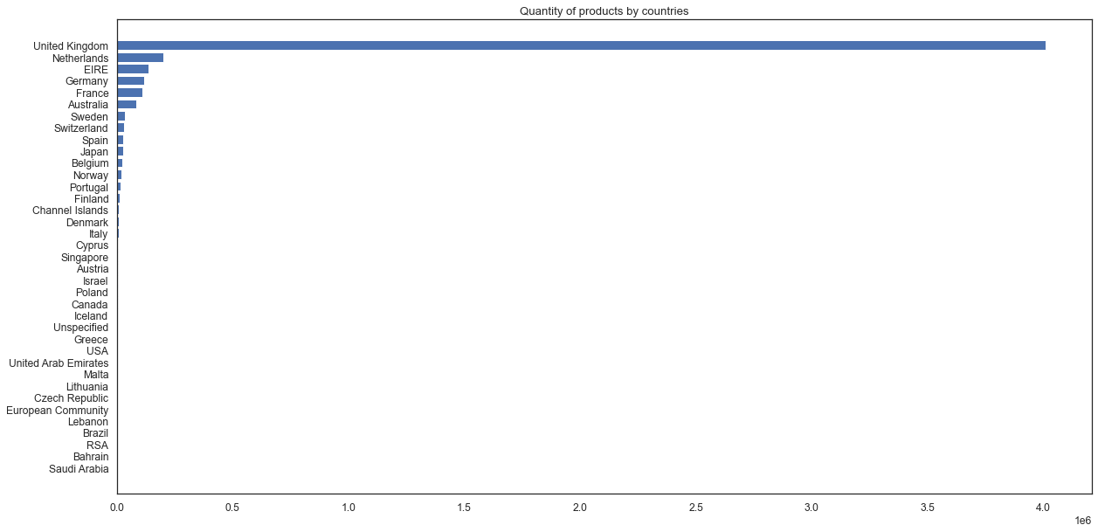
The Company
Quantity - Country

Slide 13
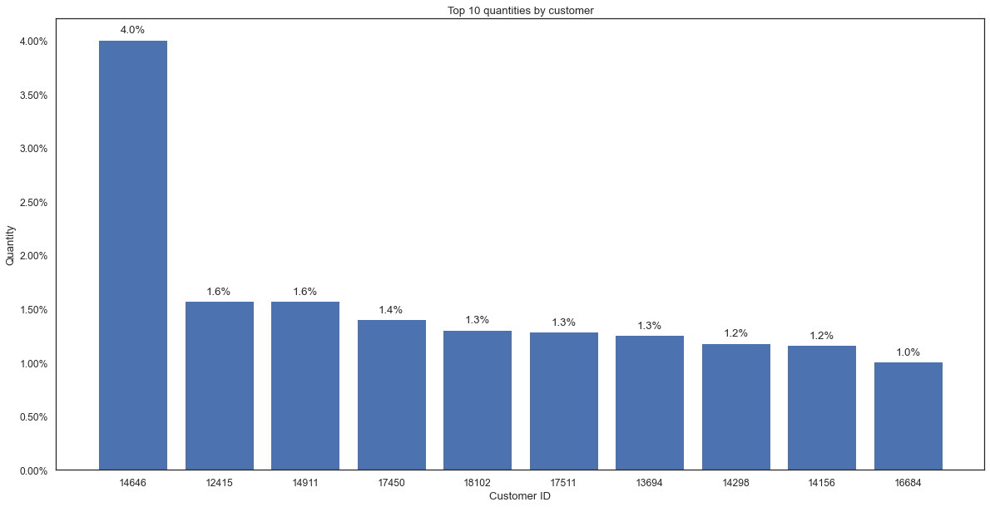
The Company
Quantity - Customers

Slide 14
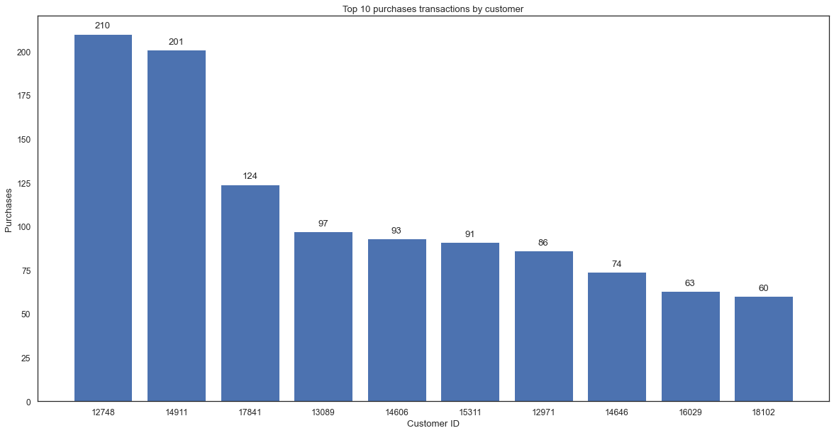
The Company
Purchase Transactions - Customers
Average: 4.24

Slide 15
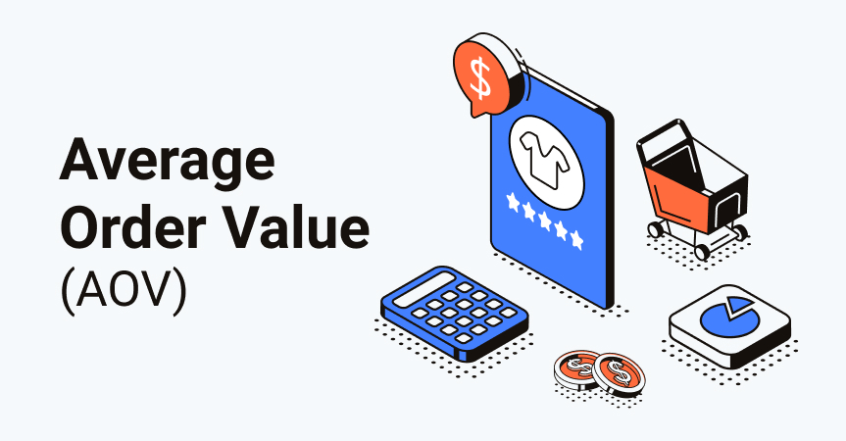

Slide 16
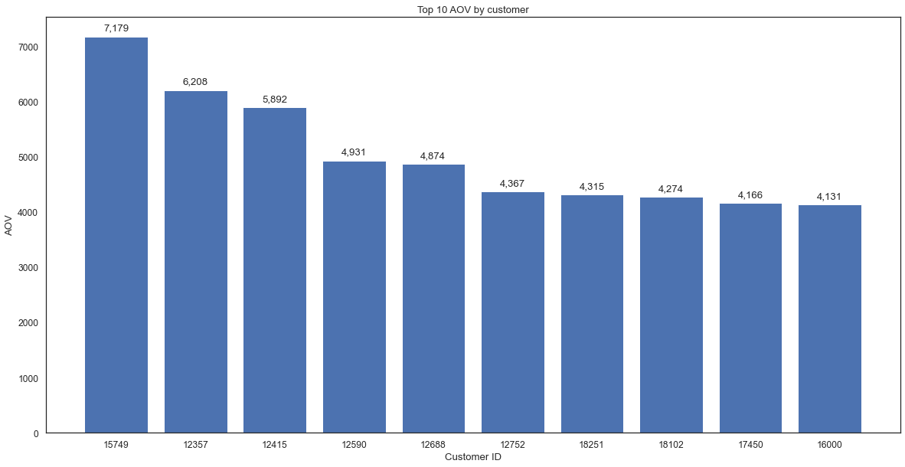
The Company
Average Order Value - Customers
Average: 362.72

Slide 17

Customer Lifetime Value

Slide 18
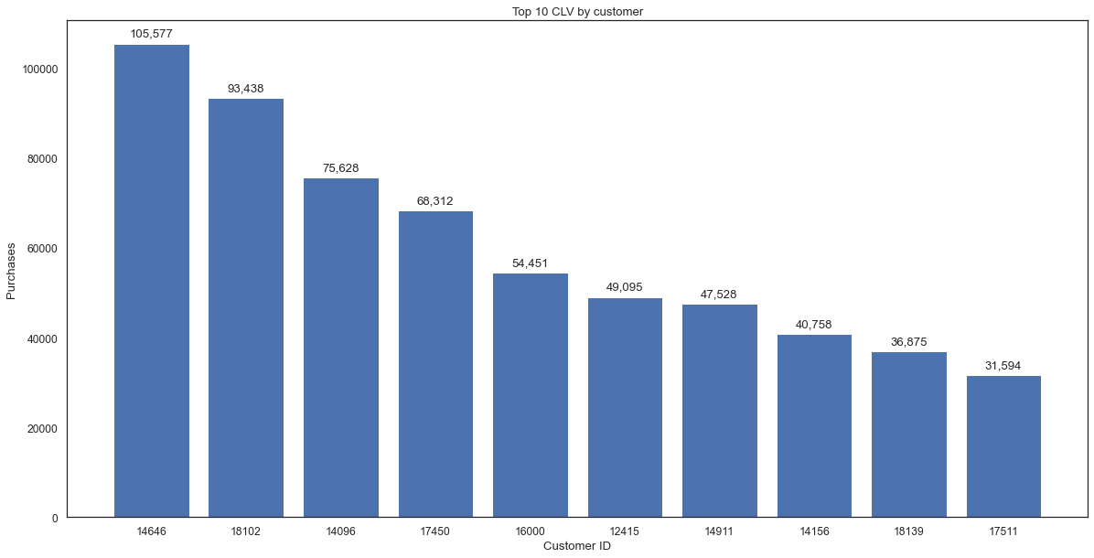
The Company
Customer Lifetime Value - Customers
Average: 1,159.94

Slide 19

Insiders Project

Slide 20


Loyalty Program
Insiders Project
Objectives
Eligible customers:
Buy more expensive products
High frequency purchases
High revenue contribution
Increase sales and purchase frequency

Slide 21
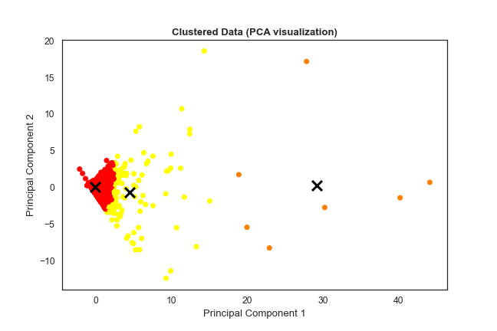
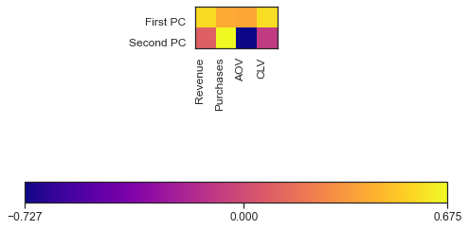
Insiders Project
Customer Segmentation – K-Means

Slide 22
Insiders Project
Customer Segmentation – K-Means
Feature | Cluster 1 (Red) | Cluster 2 (Yellow) | Cluster 3 (Orange)
Number of customers | 4,241 (97.0%) | 124 (2.8%) | 7 (0.2%)
Average revenue ($) | 1,192.2 | 16,884,8 | 164,316.1
Average quantity | 724.4 | 10,300.5 | 79,664.6
Average purchases | 3.6 | 21.6 | 67.6
Average returns | 0.7 | 4.7 | 13.1
Average AOV ($) | 321.8 | 1,588.9 | 3,455.7
Average CLV | 837.8 | 8,368.8 | 68,619.4

Slide 23
Insiders Project
Customer Segmentation – K-Means
Feature | Cluster 1 (Red) | Cluster 2 (Yellow) | Cluster 3 (Orange)
Number of customers | 4,241 (97.0%) | 124 (2.8%) | 7 (0.2%)
Average revenue ($) | 1,192.2 | 16,884,8 | 164,316.1
Average quantity | 724.4 | 10,300.5 | 79,664.6
Average purchases | 3.6 | 21.6 | 67.6
Average returns | 0.7 | 4.7 | 13.1
AOV ($) | 321.8 | 1,588.9 | 3,455.7
CLV | 837.8 | 8,368.8 | 68,619.4

Slide 24
Insiders Project
Customer Segmentation – K-Means
Feature | Normal Customers | Insiders Customers
Number of customers | 4,241 (97.0%) | 131 (3.0%)
Average revenue ($) | 1,192.2 | 24,762.8
Average quantity | 724.4 | 14,006.9
Average purchases | 3.6 | 24.0
Average returns | 0.7 | 5.1
AOV ($) | 321.8 | 1,688.7
CLV | 837.8 | 11,588.3

Slide 25
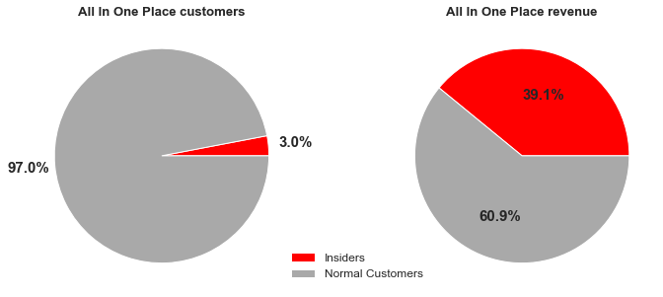
Insiders Project
Insiders - Revenue

Slide 26
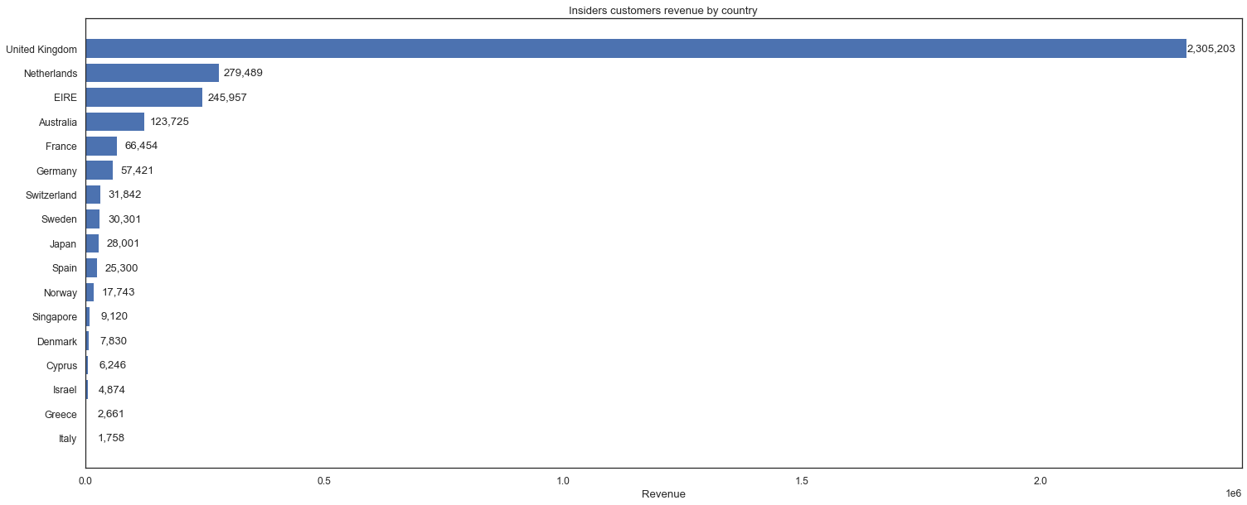
Insiders Project
Insiders - Revenue by Country

Slide 27
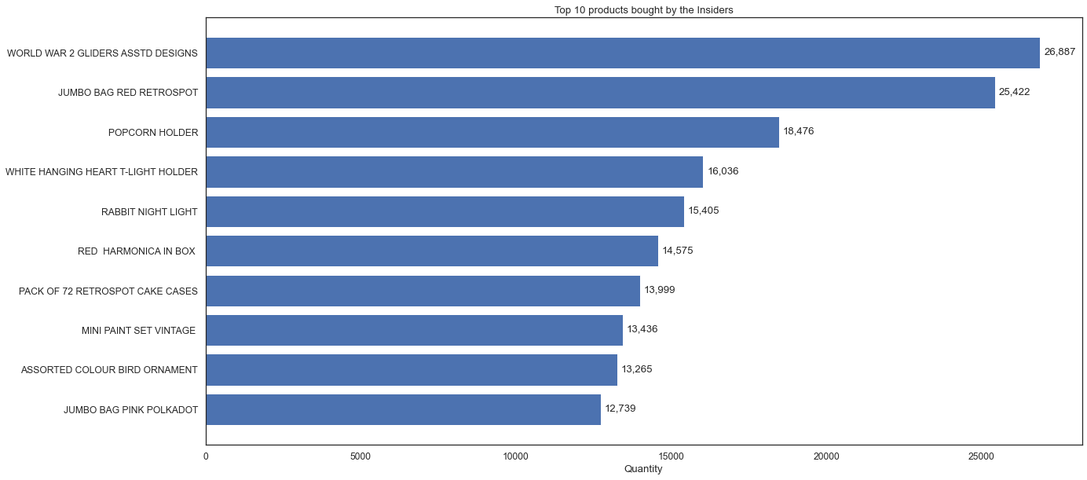
Insiders Project
Insiders - Products

Slide 28



Henrique Issamu Umeda issamuumeda@gmail.com /henriqueissamu /henriqueumeda

